Slide 1
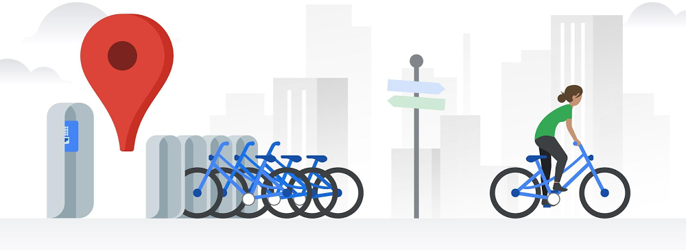
Cyclistic Bike-share User Analysis
Presented on 7th Jun. 2022

Slide 2
CONTENT
Business Info
Business Task
Data Integrity
Data Visualization
Recommendation

Slide 3
Business Info
5,824 bicycles provide bike-share service in Chicago
Pricing plans: single-ride passes, full-day passes, and annual memberships
casual riders
Cyclistic members
30% use our service to commute to work each day, 70% use for leisure
Bicycle Type: classic bike, docked bike, electric bike

Slide 4
Business Task
Finance analysts have concluded that annual members are much more profitable than casual riders
To convert casual riders into members
Target casual riders and analyze their behaviors
How do annual members and casual riders use Cyclistic differently?

Slide 5
Data Integrity
Data Source: internal data
Data Range: 20210501-20220430 (one year)
Data Owner: director of marketing
Data Consent: approved by the data owner
Data protection: customer personal information removed, only accessible to limited user
Data update: update monthly by data team

Slide 6
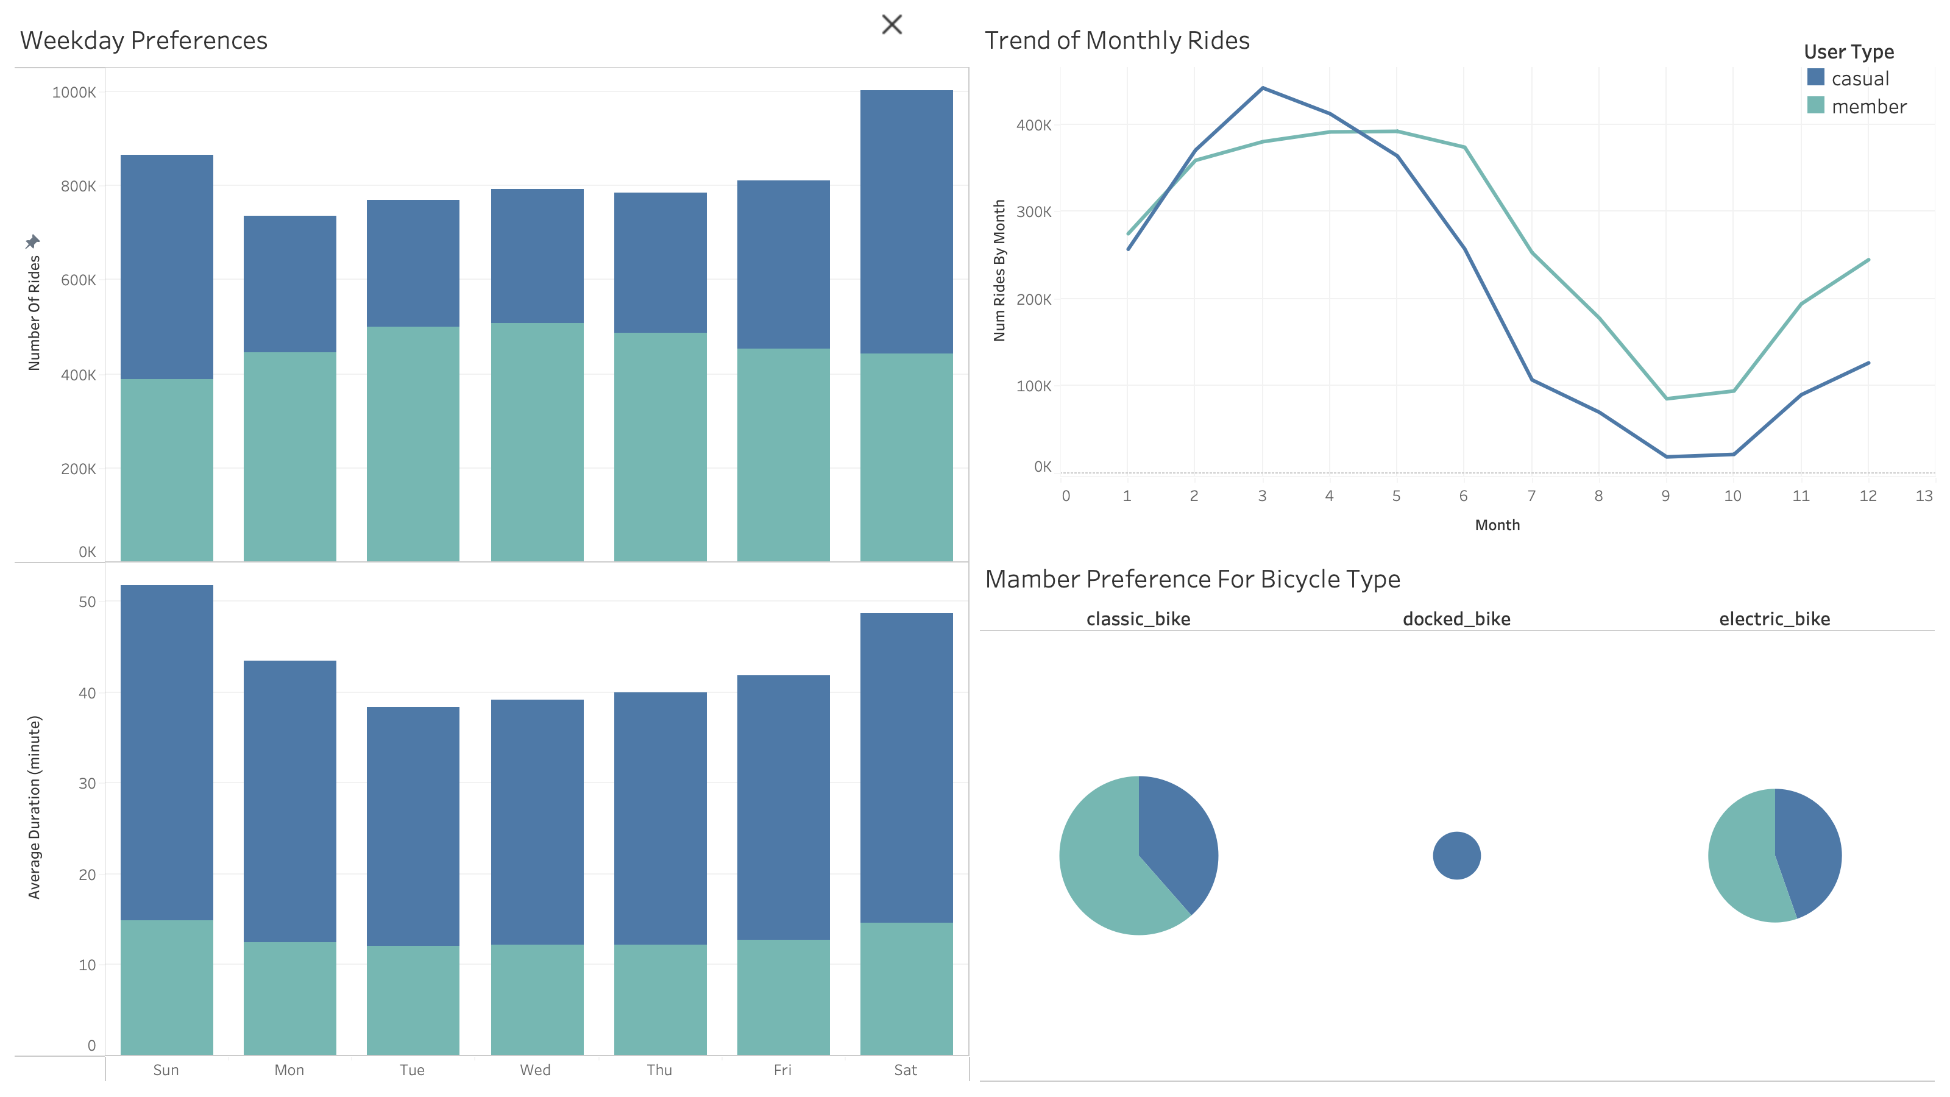
Data Visualizations
There is seasonal treands of rides
Spring season (month 2,3,4) with the highest volumn
Casual users use more at the peak season than members
Only casual riders use docked bike
Members use classic bike more

Slide 7
Data Visualizations
Casual riders use our service more during the weekend while members ride more during the workdays.
Casual riders tend to ride longer than the member riders.
The average ride length of casual riders is fluctuating while members’ ride length is quite stable

Slide 8
Recommendation
Launch a season pass targeting casual riders using our service frequently during Spring
More discount or promotion during the weekend for membership
Change the single ride to 30-minute pass given the casual member’s average ride is more than 30mins so they can buy longer passes
Next Step:
Figure out the reason why only casual riders use docked bikes
Figure out current conversion rate from casual riders to members

